Slide 1
Binary and Other Trees

Slide 2
Linear Lists and Trees
Linear lists are useful for serially ordered data
(e₁,e₂,e₃,…,e_{n})
Days of week
Months in a year
Students in a class
Trees are useful for hierarchically ordered data
Joe’s descendants
Corporate structure
Government Subdivisions
Software structure

Slide 3
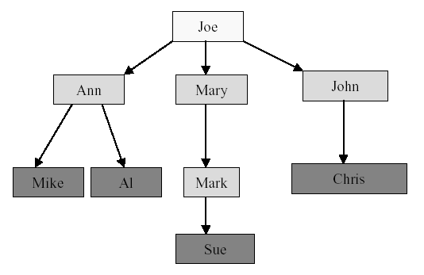
Joe’s Descendants
What are other examples of hierarchically ordered data?

Slide 4
Definition of Tree
A tree t is a finite nonempty set of elements
One of these elements is called the root
The remaining elements, if any, are partitioned into trees, which are called the subtrees of t.

Slide 5
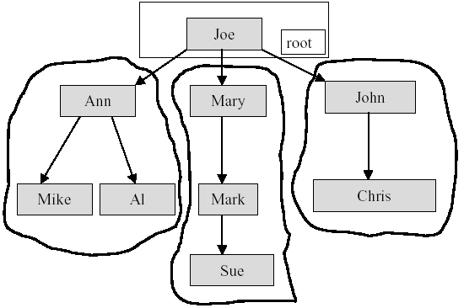
Subtrees

Slide 6
Tree Terminology
The element at the top of the hierarchy is the root.
Elements next in the hierarchy are the children of the root.
Elements next in the hierarchy are the grandchildren of the root, and so on.
Elements at the lowest level of the hierarchy are the leaves.

Slide 7
Other Definitions
Leaves, Parent, Grandparent, Siblings, Ancestors, Descendents
Leaves = {Mike,AI,Sue,Chris}
Parent(Mary) = Joe
Grandparent(Sue) = Mary
Siblings(Mary) = {Ann,John}
Ancestors(Mike) = {Ann,Joe}
Descendents(Mary)={Mark,Sue}

Slide 8
Levels and Height
Root is at level 1 and its children are at level 2.
Height = depth = number of levels
level 1
level 2
level 3
level 4

Slide 9
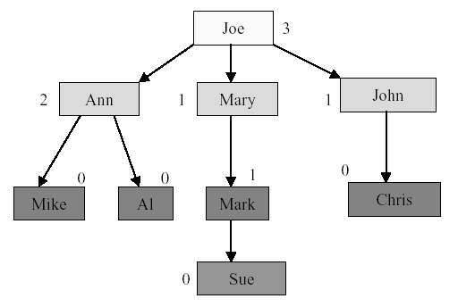
Node Degree
Node degree is the number of children it has

Slide 10
Tree Degree
Tree degree is the maximum of node degrees
tree degree = 3

Slide 11
Binary Tree
A finite (possibly empty) collection of elements
A nonempty binary tree has a root element and the remaining elements (if any) are partitioned into two binary trees
They are called the left and right subtrees of the binary tree

Slide 12
Difference Between a Tree & a Binary Tree
A binary tree may be empty; a tree cannot be empty.
No node in a binary tree may have a degree more than 2, whereas there is no limit on the degree of a node in a tree.
The subtrees of a binary tree are ordered; those of a tree are not ordered.
a
a
- different when viewed as a binary tree
- same when viewed as a tree
b
c
c
b

Slide 13
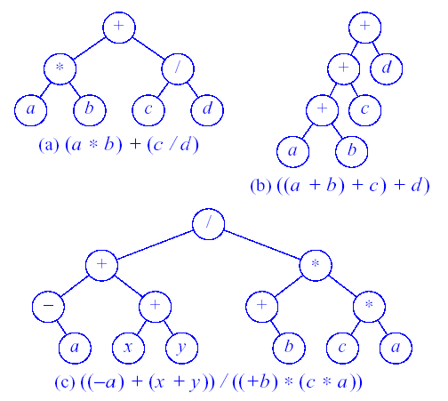
Binary Tree for Expressions
Figure Expression Trees

Slide 14
Binary Tree Properties
The drawing of every binary tree with n elements, n > 0, has exactly n-1 edges.
A binary tree of height h, h >= 0, has at least h and at most 2^{h}-1 elements in it.

Slide 15
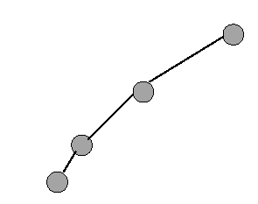
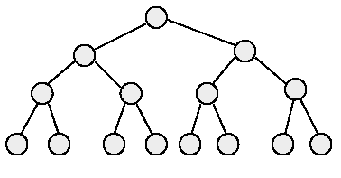
Binary Tree Properties
3. The height of a binary tree that contains n elements, n >= 0, is at least ⎡(log₂(n+1))⎤ and at most n.
minimum number of elements
maximum number of elements

Slide 16
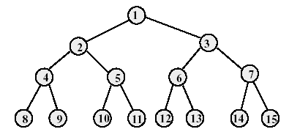
Full Binary Tree
A full binary tree of height h has exactly 2^{h}-1 nodes.
Numbering the nodes in a full binary tree
Number the nodes 1 through 2^{h}-1
Number by levels from top to bottom
Within a level, number from left to right

Slide 17
Node Number Property of Full Binary Tree
Parent of node i is node ⎣(i/2)⎦, unless i = 1
Node 1 is the root and has no parent

Slide 18
Node Number Property of Full Binary Tree
Left child of node i is node 2i, unless 2i > n, where n is the total number of nodes.
If 2i > n, node i has no left child.

Slide 19
Node Number Property of Full Binary Tree
Right child of node i is node 2i+1, unless 2i+1 > n, where n is the total number of nodes.
If 2i+1 > n, node i has no right child.

Slide 20
Complete Binary Tree with N Nodes
Start with a full binary tree that has at least n nodes
Number the nodes as described earlier.
The binary tree defined by the nodes numbered 1 through n is the n-node complete binary tree.
A full binary tree is a special case of a complete binary tree
See Figure 11.7 for complete binary tree examples
See Figure 11.8 for incomplete binary tree examples

Slide 21
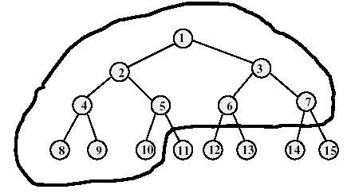
Example of Complete Binary Tree
Complete binary tree with 10 nodes.
Same node number properties (as in full binary tree) also hold here.

Slide 22
Binary Tree Representation
Array representation
Linked representation

Slide 23
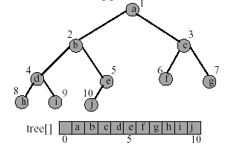
Array Representation of Binary Tree
The binary tree is represented in an array by storing each element at the array position corresponding to the number assigned to it.

Slide 24
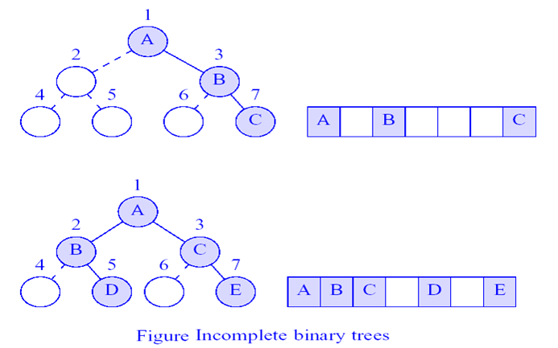
Incomplete Binary Trees
Complete binary tree with some missing elements

Slide 25
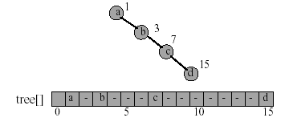
Right-Skewed Binary Tree
An n node binary tree needs an array whose length is between n+1 and 2^{n}.
Right-skewed binary tree wastes the most space
What about left-skewed binary tree?

Slide 26
Linked Representation of Binary Tree
The most popular way to present a binary tree
Each element is represented by a node that has two link fields (leftChild and rightChild) plus an element field Each binary tree node is represented as an object whose data type is binaryTreeNode The space required by an n node binary tree is n * sizeof(binaryTreeNode)

Slide 27
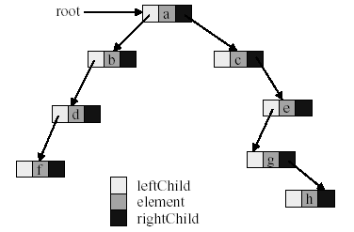
Linked Representation of Binary Tree

Slide 28
Node Class For Linked Binary Tree
template<class T>
class binaryTreeNode {
private:
T element;
binaryTreeNode<T> *leftChild, *rightChild;
public: // 3 constructors
binaryTreeNode() { leftChild = rightChild = NULL; } // no params
binaryTreeNode(const T& theElement) { // element param only
element = theElement; leftChild = rightChild = NULL;
}
binaryTreeNode(const T& theElement, binaryTreeNode *l, binaryTreeNode *r) { // element + links params
element = theElement; leftChild = l; rightChild = r;
}
}

Slide 29
Common Binary Tree Operations
Determine the height
Determine the number of nodes
Make a copy
Determine if two binary trees are identical
Display the binary tree
Delete a tree
If it is an expression tree, evaluate the expression
If it is an expression tree, obtain the parenthesized form of the expression

Slide 30
Binary Tree Traversal
Many binary tree operations are done by performing a traversal of the binary tree
In a traversal, each element of the binary tree is visited exactly once
During the visit of an element, all actions (make a copy, display, evaluate the operator, etc.) with respect to this element are taken

Slide 31
Binary Tree Traversal Methods
Preorder
The root of the subtree is processed first before going into the left then right subtree (root, left, right).
Inorder
After the complete processing of the left subtree the root is processed followed by the processing of the complete right subtree (left, root, right).
Postorder
The root is processed only after the complete processing of the left and right subtree (left, right, root).
Level order
The tree is processed by levels. So first all nodes on level i are processed from left to right before the first node of level i+1 is visited

Slide 32
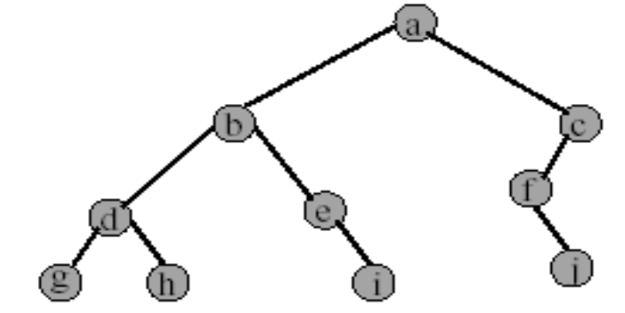
Preorder Example (visit = print)
a b d g h e i c f j

Slide 33
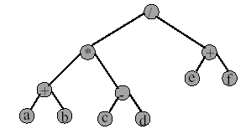
Preorder of Expression Tree
/ * + a b - c d + e f
Gives prefix form of expression.

Slide 34
Inorder Example (visit = print)
g d h b e i a f j c

Slide 35
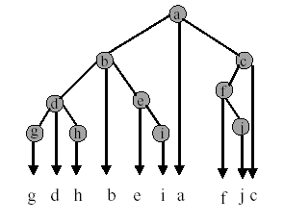
Inorder by Projection (Squishing)

Slide 36
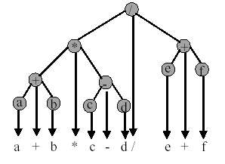
Inorder of Expression Tree
Gives infix form of expression, which is how we normally write math expressions. What about parentheses?
See Program 11.6 for parenthesized infix form
Fully parenthesized output of the above tree?

Slide 37
Postorder Example (visit = print)
g h d i e b j f c a

Slide 38
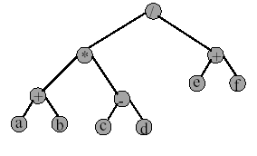
Postorder of Expression Tree
a b + c d - * e f + /
Gives postfix form of expression.

Slide 39
Level Order Traversal (Brth

Slide 40
Level Order Example (visit = print)
Add and delete nodes from a queue
Output: a b c d e f g h i j

Slide 41
-Copying Binary Trees
-Equality of Binary Trees (the same topology and data)
-topological similarity(Shape Comparison)

